Slide 1
Bakery Sales Prediction
Gibrail Hassan

Slide 2
What do we have?
Almost 6 years of daily sales data for 6 different bakery products
Each grave has some characteristic
Different items found in the graves, gender of the body, grave area, health condition etc

Slide 3

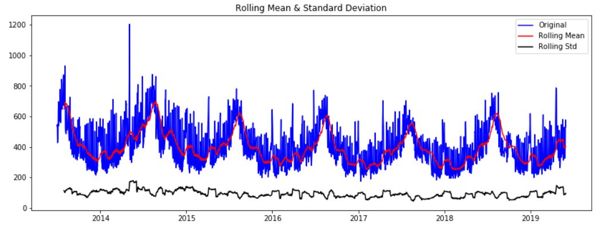
Rolling mean & std Deviation?

Slide 4
What analysis has been done
Sales prediction with LSTM
Prediction with Prophet
Statistical Analysis
Designed an LSTM model which can predict upto one year sales with 10 to 12 % error.
Facebook Prophet is a prediction model
Analysed average salaries over days, weeks, months, quarters and years.

Slide 5
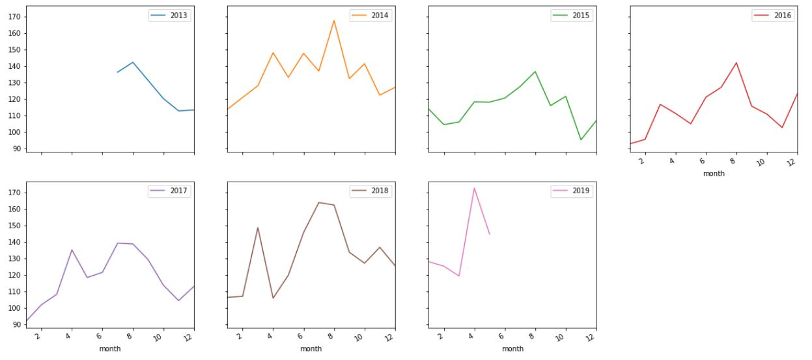
Sales over different years

Slide 6
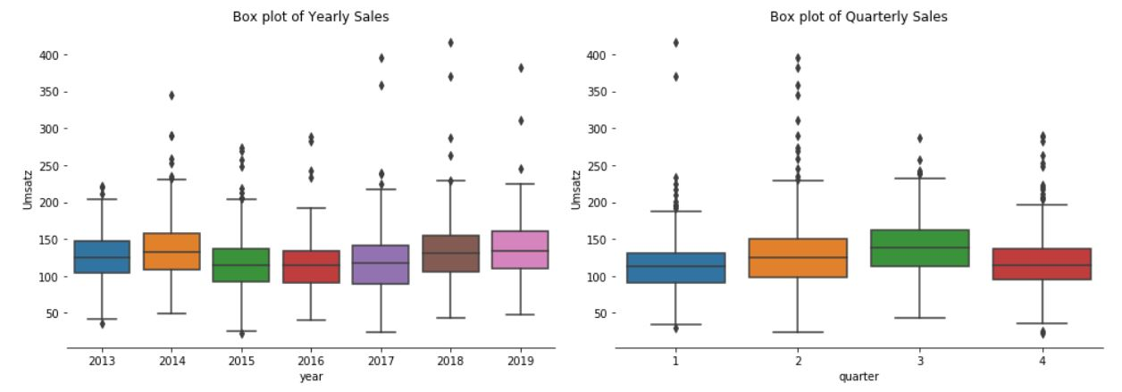

Slide 7
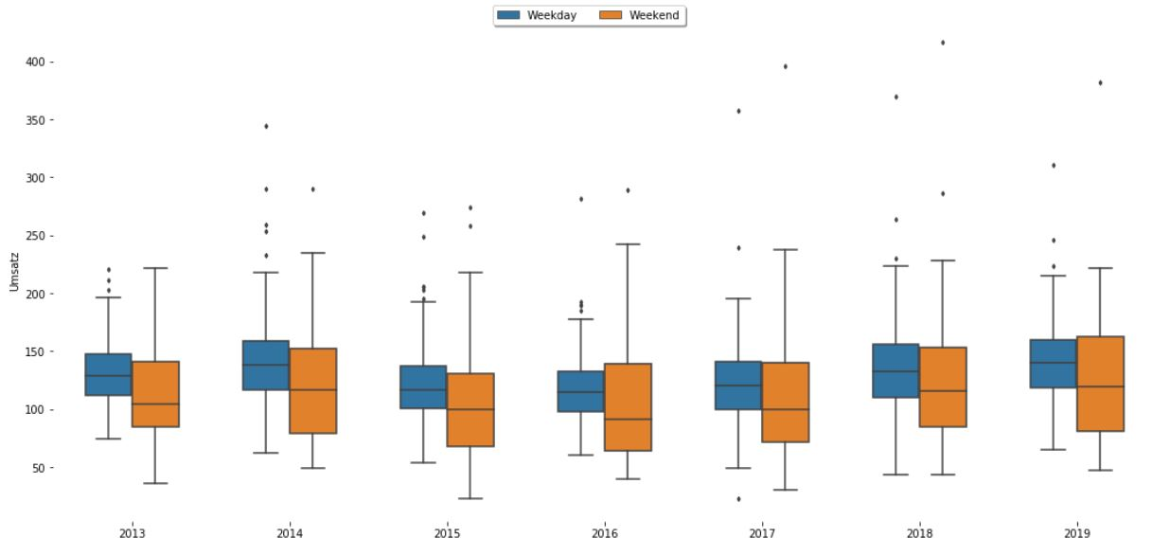
Weekends vs Weekdays

Slide 8
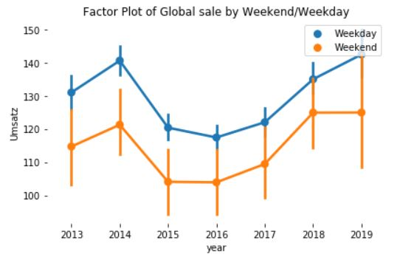
Weekdays vs Weekends

Slide 9
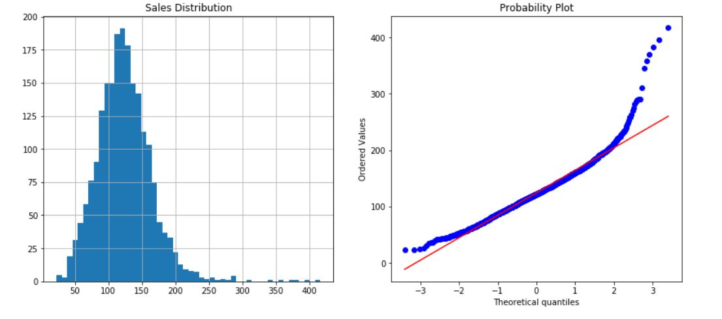
Probability Distribution

Slide 10
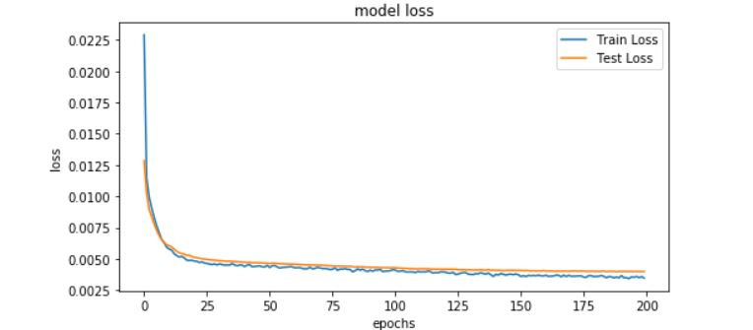
Loss curves

Slide 11
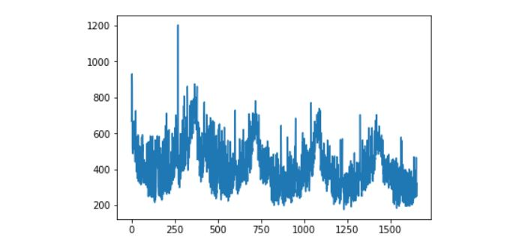
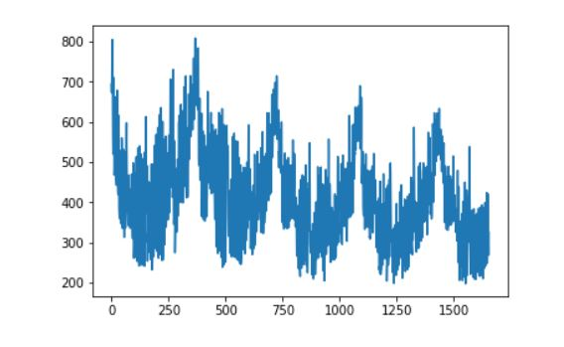
Training Data vs Training Prediction

Slide 12
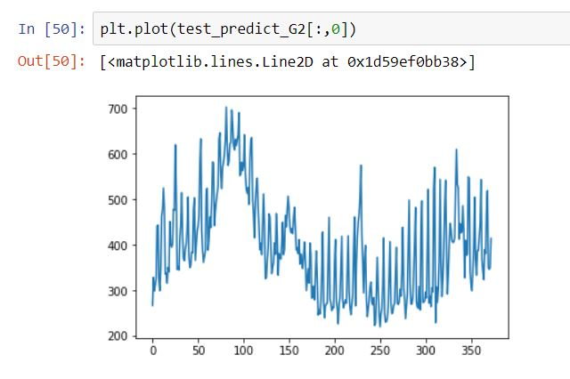
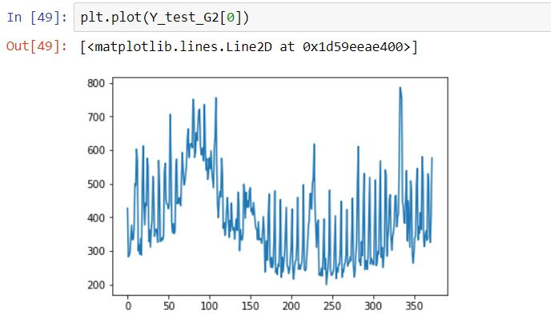
Test Data vs Test Prediction

Slide 13
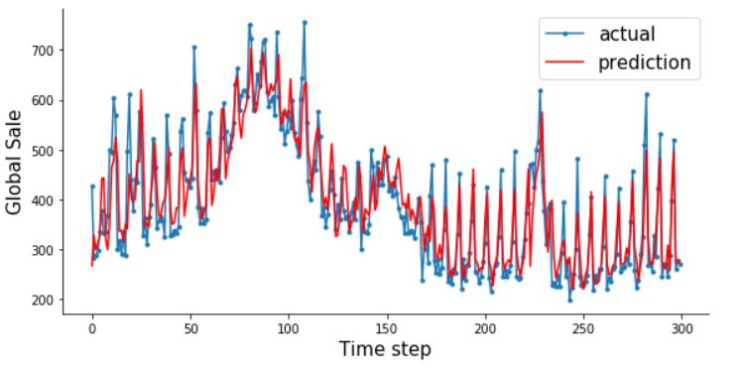
Prediction for next 300 days

Slide 14
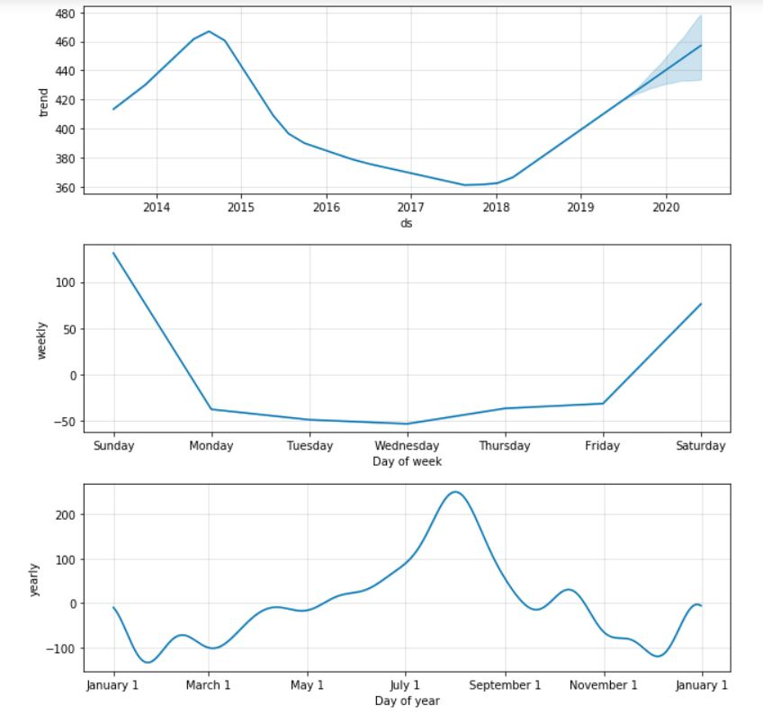
Trends

Slide 15
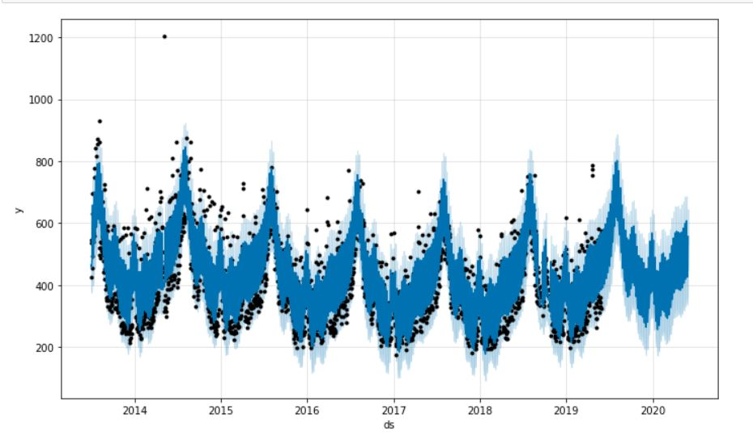
Prophet Prediction

Slide 16
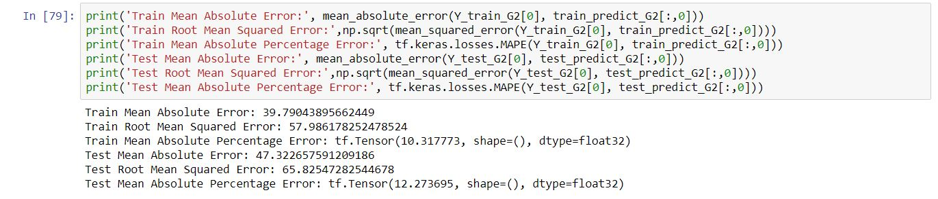
Evaluation

Slide 17
Any Questions?

Slide 18
Thank You!

